Slide 1
Internship Presentation
By Samiya

Slide 2
Task Overview:
Chatbot using GraphRAG
Task/Research Assigned: Implement the GraphRAG method to create a document-based Chatbot.
Technology used: Python, Langchain, Neo4j, HuggingFace, & Streamlit.
Aim: Improve chatbot accuracy to generate an accurate response.

Slide 3
Timeline
PHASE 1: Introductory sessions with my mentor and learning the courses on DeepLearning.AI to have an understanding of the task.
PHASE 2: Initial code on Jupyter Notebook.
PHASE 3: Created the UI using Streamlit.
PHASE 4: Adding finishing touches to the code and UI.

Slide 4
Terms
01
Vectors
04
Knowledge Graph
02
Embeddings
05
LLM
03
GraphRAG

Slide 5
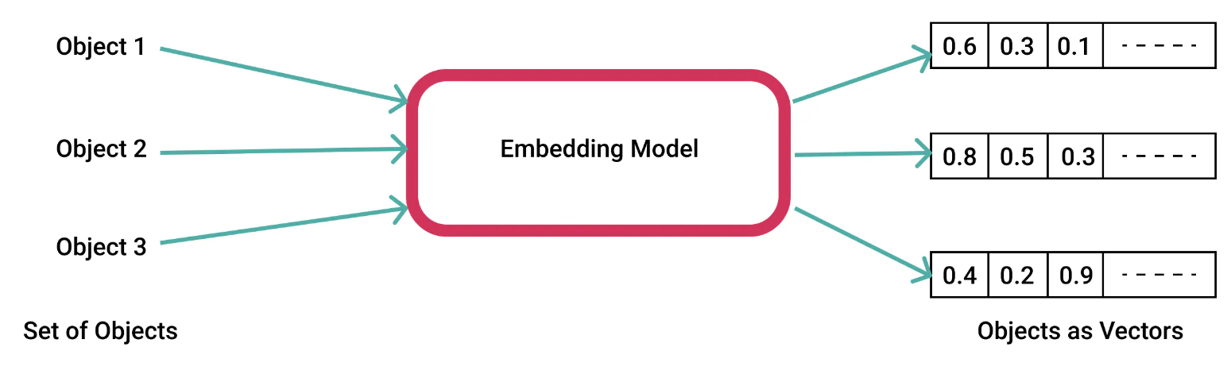
Vectors & Embeddings
Vectors represent data points in a multi-dimensional space, known as vector space. They are sets of numbers used to represent things like words, pixels, or objects in that space.
Embeddings are a specific type of vector used to represent text as numerical data. These are numerical representations of values or objects like text, images, and audio that are designed to be understood by machine learning models and semantic search algorithms.

Slide 6
What is RAG & GraphRAG?
Rag, or Retrieval-Augmented Generation, is the process of optimising the output of a large language model (LLM), so it references an authoritative knowledge base, like a document provided by the user, outside of its training data sources before generating a response.
Whereas, GraphRAG represents a significant advancement from baseline RAG because it leverages structured knowledge from graphs to enhance the contextuality, accuracy, and relevance of generated text across various applications.

Slide 7
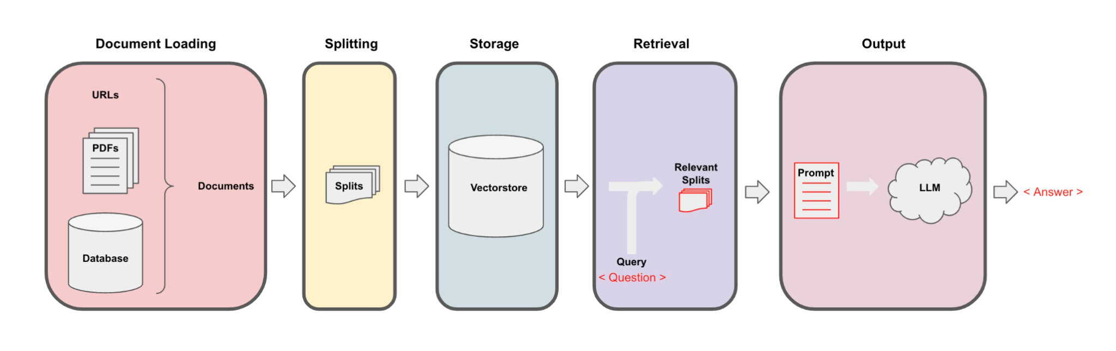
RAG Process
Source: DeepLearning.AI (Langchain chat with your data)
In RAG, an LLM retrieves contextual documents from an external dataset as part of its execution. This is useful if we want to ask question about specific documents

Slide 8
What is a Knowledge Graph?
A knowledge graph (or semantic network) represents a network of real-world entities—such as objects, events, situations or concepts—and illustrates the relationship between them; so it structures data using entities (nodes) and relationships (edges) to represent knowledge.
In the chatbot, the knowledge graph stores information to allow the chatbot to reason and infer new knowledge from the relationships between data points.

Slide 9
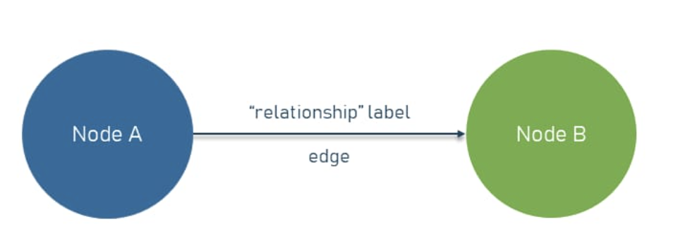
Neo4j
Neo4j is a widely used graph database utilised for its high performance, scalability, and open-source nature. At its core, it stores data in the form of nodes, relationships, and properties, making it an ideal choice for handling complex data relationships.
Graph databases represent data through relationships rather than traditional tabular formats. These graphs consist of nodes and edges.
Nodes represent entities (ex Persons or Places), while edges represent relationships between these nodes. Both nodes and relationships can have properties to store additional metadata.
Furthermore, its ability to establish relationships between nodes allows users to query the data flexibly and efficiently using Cypher, Neo4j’s query language. Cypher is a declarative query language that allows us to query the data in our Neo4j database. This makes it easy to extract insights and patterns from the data.

Slide 10
LLM (Large Language Model)
LLMs are trained on vast amounts of data and use billions of parameters to comprehend and generate original output similar to human-like responses.
These models are built using machine learning techniques, specifically a type of neural network known as a transformer model.
A transformer model learns context and thus meaning by tracking relationships in sequential data, like the words in a sentence.

Slide 11
LLM model used
The "mistralai/Mistral-7B-Instruct-v0.3" LLM model from HuggingFace was implemented for this project. It is designed to provide high-quality, detailed responses to user instructions.
Key features:
7 billion parameters.
Efficient in processing and understanding instructions.
Suited for chatbots, question-answering, and document retrieval.
Hence, it was chosen because it is optimised for generating human-like responses and performs well across various NLP tasks such as text generation, Q&A systems, summarising, and more.

Slide 12
How does the Chatbot generate a response?
Creating Document Embeddings:
Documents are converted into embeddings using the LLM model.
These vector embeddings are stored in a Neo4j vector database for efficient retrieval.
How Query Embeddings Work:
When a user asks a question, the chatbot converts the query into an embedding. This query embedding is compared with the document embeddings in the database to find the most relevant documents.
Similarity Search:
This is used to compare vectors by measuring how close the query vector is to the document vectors from a value between 0.0-1.0. The document with the highest similarity score is returned as the best match.

Slide 13
User Interface (UI) - Streamlit
Streamlit, an open-source Python framework, was used to create an interactive website for the Chatbot, allowing users to interact with the model by uploading documents and chatting with the bot.

Slide 14
Demo

Slide 15
Challenges & Solutions
Connecting to the Neo4j Database.
Solution: Used Jupyter Notebook because it can be run locally.
API Rate Limiting: 429 Client Error: Too Many Requests: Faced this error when making API calls, which restricted the frequency of requests and impacted performance.
Solution: set the HF_TOKEN in the working environment.
Chunk Overlap Adjustment: Initially set chunk overlap to 20, which resulted in losing semantic connections in the text.
Solution: Adjusted overlap to 50 (10% of chunk size - 500) to better preserve context and improve the quality of embeddings.

Slide 16
Achievements
Developed a functional GraphRAG system that integrates document retrieval with chat functionalities, enhancing user interactions.
Designed and implemented a user interface using Streamlit, improving user engagement and accessibility.
Gained insights from the mentor's code, which facilitated understanding and implementation, allowing for efficient troubleshooting and adaptation of features.

Slide 17
Future Improvements
Advanced Similarity Search Techniques (ex FAISS)
Let user upload different types of documents
Build the UI for the Chatbot using HTML and CSS instead to implement more features.

Slide 18
Conclusion
Through this internship I’ve successfully implemented the GraphRAG system, integrating document retrieval and chatbot functionality with a user-friendly interface. Further, I’ve gained a deeper understanding of LLMs, vector embeddings, similarity search, Neo4j integration, and enhanced my skills in developing a user interface (UI).

Slide 19
Thank You!

